Slide 1



Slide 2

Crypto Payment Gateway
Supervised by:
Dr. Chaudary Shahzad Faisal
Co. Supervisor:
Dr. Khalid Mehmood
Group Members:
Haider Yaqoob (Sp17-BCS-012)
Aamir Mushtaq (Sp-BCS-001)
Department of Computer Science
COMSATS University Islamabad, Attock Campus

Slide 3
Outline
_______________________________
Introduction
Project Background.
Methodology & Software Lifecycle
Problem Statement
UseCase Diagrams
Functional Requirements
Non-Functional Requirements
Design & Architecture
System Architecture & Data Representation
_______________________________

Slide 4
Cont…
_______________________________
Implementation
Algorithms
External Api’s
Testing & Evaluation
Manual Testing
Automation Testing
Conclusion & Future work
Tools
_______________________________

Slide 5
Introduction
Cryptocurrency is a digital form of currency, it uses blockchain technology that acts as a tool for implementation.
This prevents double spending and removes the need for centralized payment processors to verify funds and record transactions.
In our crypto payment gateway when a buyer comes to merchant website and wants to pay in bitcoin we will show him an address. Buyer will send amount in the provided address. This system will be blockchain based which will ensure that one entity will not be able to control or manipulate the system.

Slide 6
Project Background & Literature Review
Cryptocurrency payment gateways are borderless payment networks that allow smooth transfer of cryptocurrencies and enables users and merchants to do transactions in bitcoins.
No third-party between a merchant and a customer (user). Merchant is always in full control of the funds.
Previous payments gateways have few issues: The security provided by a payment gateway cannot completely protect and secure a customer’s confidential payment information.
Transaction speed and confirmation is also an issue in existing crypto payment gateways so the slower transaction confirmation results in the merchant taking a longer time to receive payment and process his product purchase.

Slide 7
Methodology & Software Lifecycle
Software Methodology:
We are using Microservices method to develop our system. Reason behind selecting this method is because, it’s easy to develop a system when its broken into smaller pieces which can then work together. Each part of system can be developed separately.
Process Methodology:
We are using Iterative and Incremental process model for our system, Main reason is that it breaks the system functionality into increments. We can evaluate system according to requirements after each iteration.

Slide 8
Problem Statement
There are few online payment problems that user face, these are follows:
Transaction Speed & Confirmation: The slower transaction confirmation results in the merchant taking a longer time to receive payment and process his product purchase. This creates a hassle for both client and the merchant.
Chargeback: A chargeback is also a problem for merchant. A customer charges back the money to demand a refund after making a purchase. These chargebacks can have a negative impact on the store’s rating.
Hidden Fee Structure: Payment gateways make it as difficult as possible to know how much markup you’re paying by using bewildering terms and pricing models.
Security: Some payment gateways have also security related issues.

Slide 9
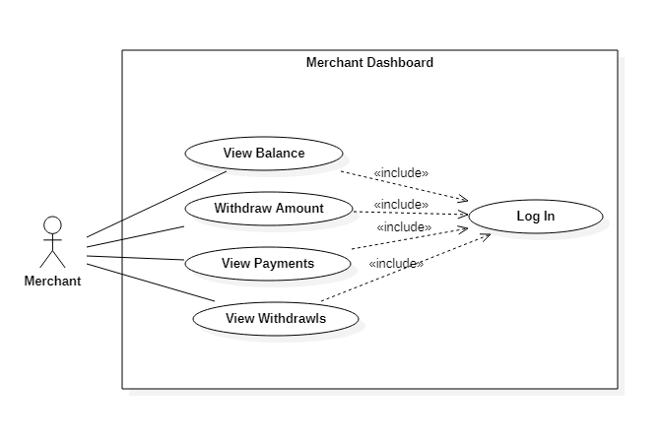
Use Case Diagrams

Slide 10
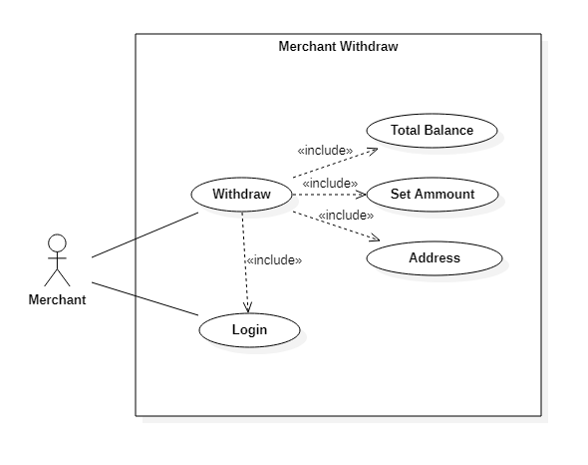
Cont..

Slide 11
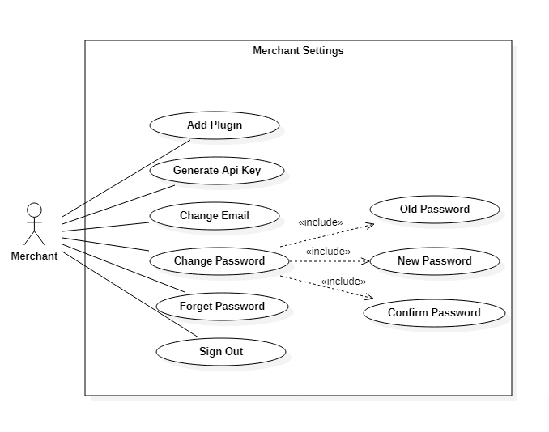
Cont..

Slide 12
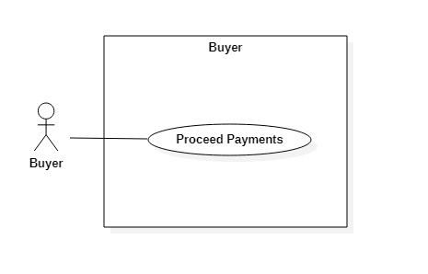
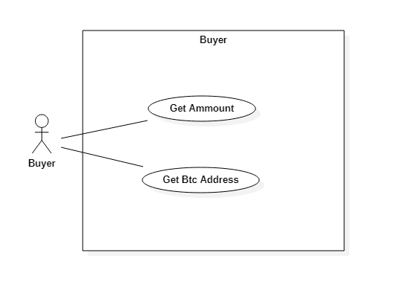
Cont..

Slide 13
Functional Requirements
The functional requirement of any system is the specific behaviour and mandatory functions of that system.
After signup and login, merchant can send and receive bitcoin in first step.
Merchant can view his account balance, the payments he receive, and the withdrawals he make. To withdraw balance, he need to enter the amount and the address he want to send the balance.
We also provide the integration plugin to the merchant, in order to integrate the payment gateway with his store on wordpress.
The customer of merchant proceeds the order of any product He needs to put the amount and the bitcoin address to proceed the transaction.

Slide 14
Cont...
Security requirement: Safety is essential for a software system. Unregistered user cannot access the system. Safety requirement is maintained through providing individual account to each merchant.

Slide 15
Non-Functional Requirements
User friendly Interface:Interface of our payment gateway will be easy to use so that even a non technical person can easily use that system and user will have a better user experience.
Portability:
This system must run on multiple devices and in any browser with any version without any browser compatibility issues.
Cost effective:
Low cost to mercahnt and his end users.

Slide 16
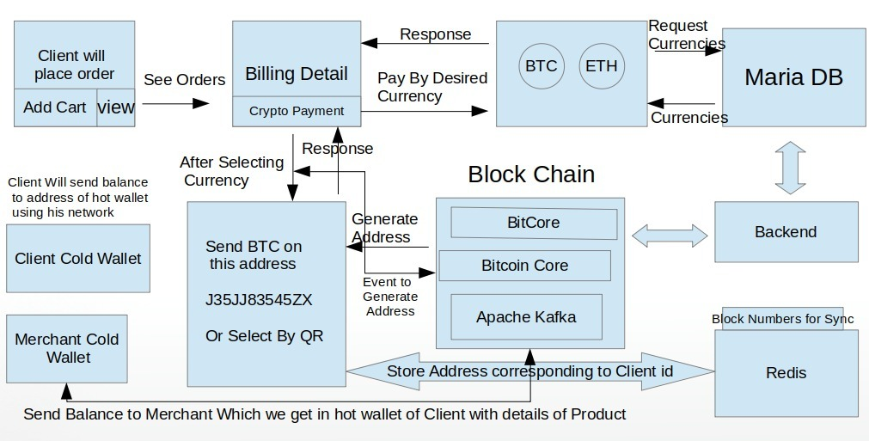
Design And Architecture
System Architecture

Slide 17
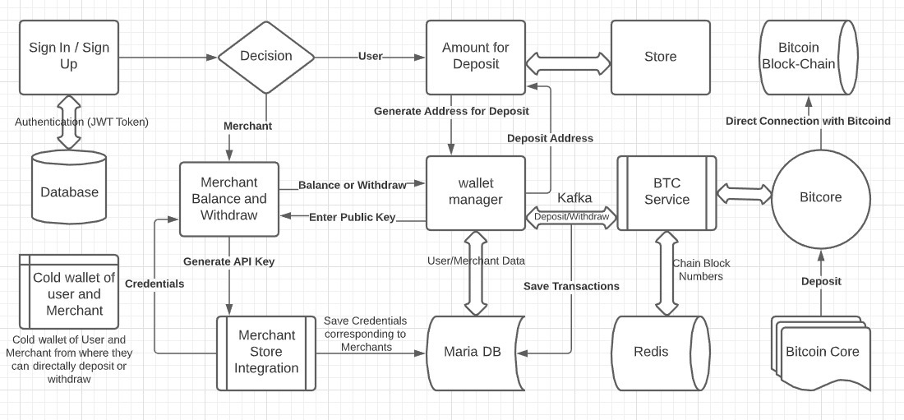
Cont...
Data Representation

Slide 18
Implementation
Algorithm
Elliptic Curve Digital Signature Algorithm or ECDSA
Elliptic Curve Digital Signature Algorithm or ECDSA is a cryptographic algorithm used by Bitcoin to ensure that funds can only be spent by their rightful owners.
Cryptographic Hash Functions
SHA256 algorithm
Different blockchains use different cryptography algorithms. The Bitcoin blockchain uses the SHA256 algorithm, which produces a 32-byte hash.
ECDSA
ECDSA is the cryptographic algorithm in the core of bitcoin addresses. It is an asymmetric signature algorithm, which means that you can sign messages with the PRIVATE key and verify the signature with the PUBLIC key.

Slide 19
Cont…
External APIs
Bitcore
We use Bitcore Api that is an open source Node.js library used for a secure payment protocol and private key management. That Api is used to access private or public keys, perform peer-to-peer cryptcurrency transactions and manage the complete network in our payment gateway.
BitcoinD
We are using Bitcoind to implements the Bitcoin protocol, it provide us complete blockchain network, we have 3 networks of blockchain. The Testnet, Mainnet and Regtest. We are using Testnets for testing smart contracts, the Mainnet network for actual transactions with real bitcoin value and regtest for testing the network locally with fake transaction of bitcoin.

Slide 20
Cont…
Apache Kafka
We are also using Apache Kafka in our payment gateway which is an open-source, distributed streaming platform. We are using it for handling events; it is operating quickly, mostly due to its distributed nature. We are producing and consuming topics from one central place Instead of going to separate endpoints to get data.

Slide 21
Testing and Evaluation
ManulaTesting
System Testing
In system testing, we tested our system against simple inputs that are basic requirements of system and analyzed the output without any debugging techniques to simple observe the overall performance and reliability of system.
Unit Testing
We perform unit testing to validate that each unit or component of the software code performs as expected. We used breakpoints after and before every method execution to see the system behavior internally. It helped us to remove minor syntax errors and resolve basic functionality of the module.

Slide 22
Cont…
Functional Testing
We perform functional testing to test each function of the software application, by providing appropriate input, verifying the output against the Functional requirements. We checks User Interface, APIs, Database, Security, Client/Server communication and other functionality of the application under test conditions.
Integration Testing
We integrated the system modules and tested the functionalities after integration. All the major modules are tested side by side by actual inputs to see the results. We solved various issues of integration by debugging techniques. This functional testing allows us to test out integration of frontend with backend and blockchain specific issues.

Slide 23
Cont…
Automated Testing
We perform automated testing using special automated testing software tools to execute a test case suite.
We also test our rest Api’s with JMeter to execute performance testing, load testing and functional testing of web applications, to check how many users use our system at a time without any load on server.

Slide 24
Conclusion and Future Work
As the use of bitcoin and other virtual currencies is increasing day by day, we will also enhance our crypto payment gateway by providing support for other virtual currencies like Ethereum, Litecoin, Bitcoin Cash and Dai etc.
We will also provide additional functionalities like donating amount in crypto currencies and we will also add the functionality of integration that payment gateway with shopify or any other website.

Slide 25
Modern Tools
Devolpment tools:
Visual Studio Code.
HeidiSQL
Programming languages:
Html, Css, JavaScript.
Mariadb
Node.js
Vue.js

Slide 26


